Slide 1


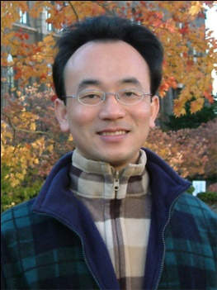
問答系統與對話系統 (Question Answering and Dialogue Systems)
Min-Yuh Day
戴敏育
Associate Professor
副教授
Institute of Information Management, National Taipei University
國立臺北大學 資訊管理研究所
https://web.ntpu.edu.tw/~myday
2020-10-23

Slide 2



戴敏育 博士 (Min-Yuh Day, Ph.D.)
國立台北大學 資訊管理研究所 副教授
中央研究院 資訊科學研究所 訪問學人
國立台灣大學 資訊管理 博士
Publications Co-Chairs, IEEE/ACM International Conference on Advances in Social Networks Analysis and Mining (ASONAM 2013- )
Program Co-Chair, IEEE International Workshop on Empirical Methods for Recognizing Inference in TExt (IEEE EM-RITE 2012- )
Publications Chair, The IEEE International Conference on Information Reuse and Integration (IEEE IRI)

Slide 3
Topics
自然語言處理核心技術與文字探勘 (Core Technologies of Natural Language Processing and Text Mining)
人工智慧文本分析基礎與應用 (Artificial Intelligence for Text Analytics: Foundations and Applications)
文本表達特徵工程 (Feature Engineering for Text Representation)
語意分析和命名實體識別 (Semantic Analysis and Named Entity Recognition; NER)
深度學習和通用句子嵌入模型 (Deep Learning and Universal Sentence-Embedding Models)
問答系統與對話系統 (Question Answering and Dialogue Systems)

Slide 4
Question Answering and Dialogue Systems

Slide 5
Outline
Question Answering
Dialogue Systems
Task Oriented Dialogue System

Slide 6
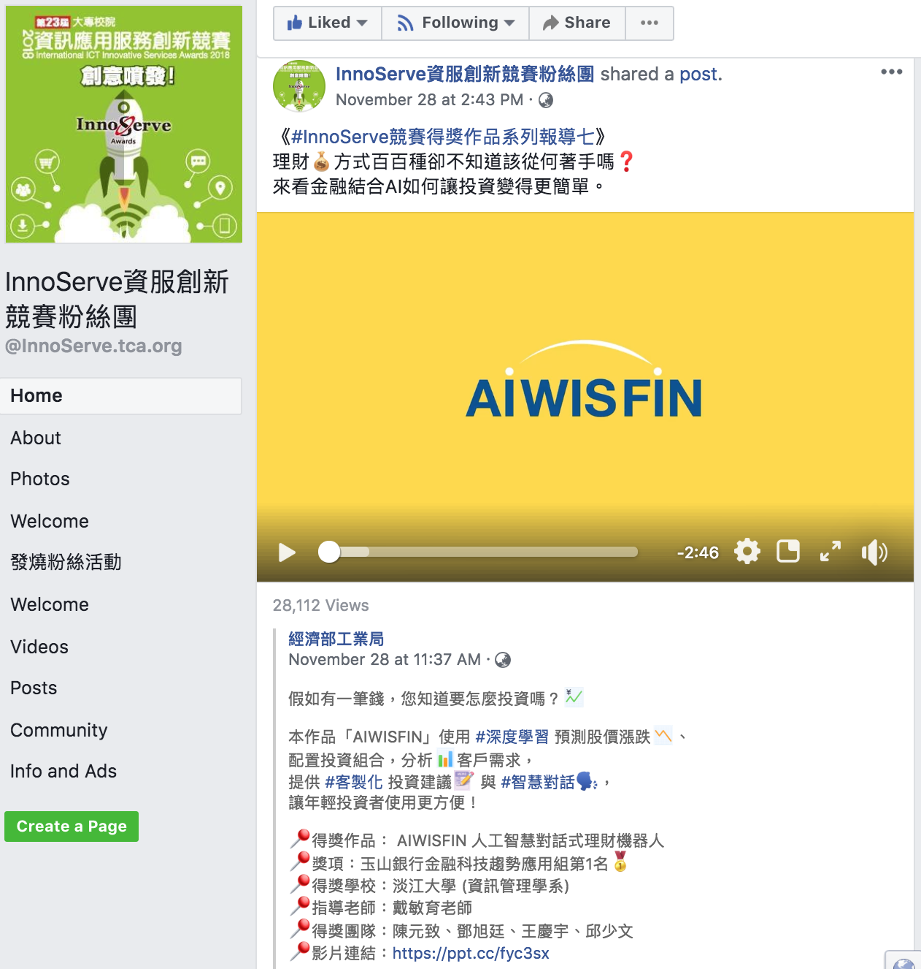
AIWISFIN AI Conversational Robo-Advisor (人工智慧對話式理財機器人)
First Place, InnoServe Awards 2018
https://www.youtube.com/watch?v=sEhmyoTXmGk

Slide 7

2018 The 23th International ICT Innovative Services Awards (InnoServe Awards 2018)
Annual ICT application competition held for university and college students
The largest and the most significant contest in Taiwan.
More than ten thousand teachers and students from over one hundred universities and colleges have participated in the Contest.
https://innoserve.tca.org.tw/award.aspx

Slide 8
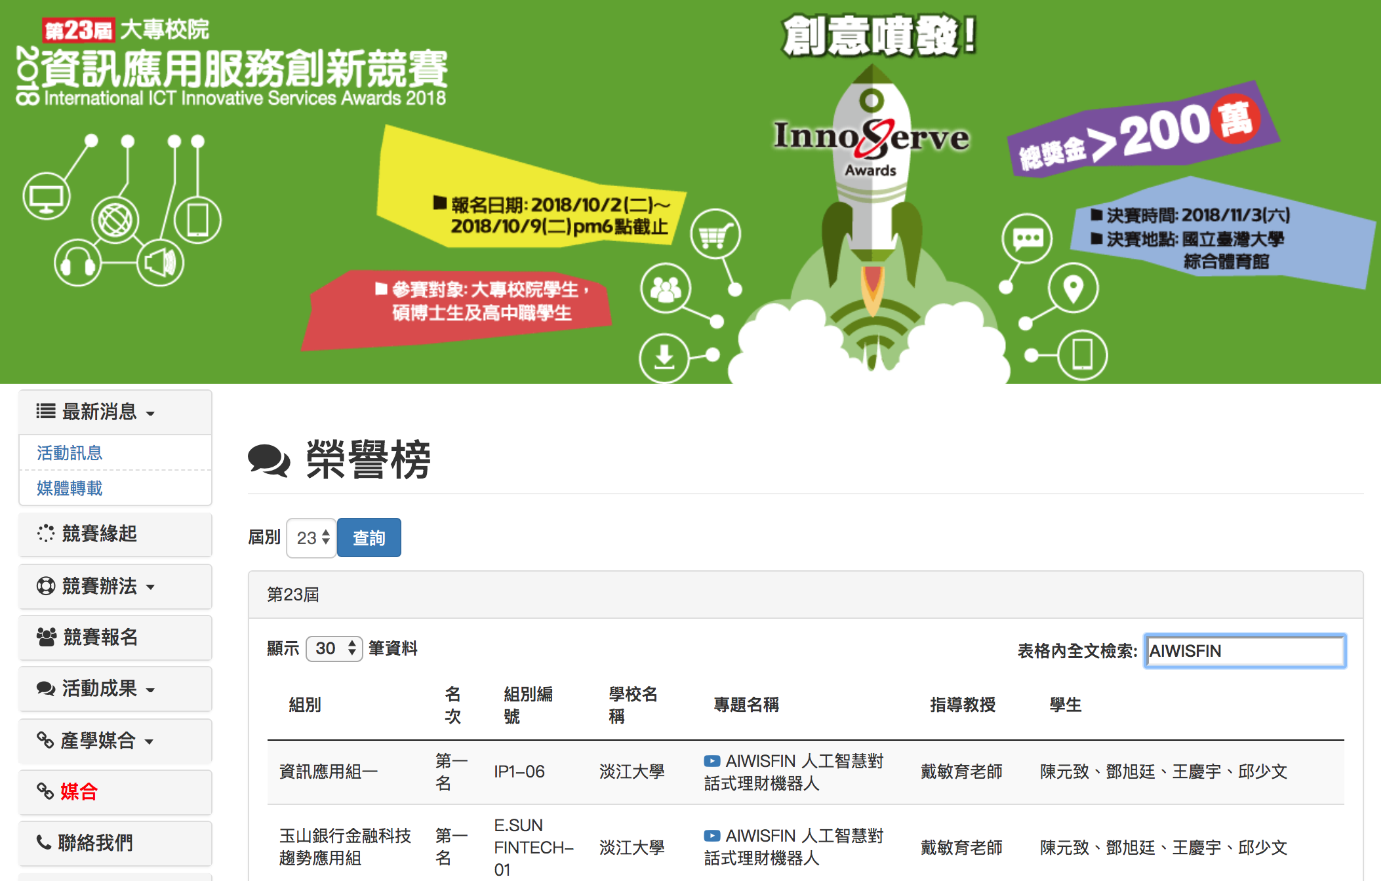
2018 International ICT Innovative Services Awards (InnoServe Awards 2018) (2018第23屆大專校院資訊應用服務創新競賽)
https://innoserve.tca.org.tw/award.aspx

Slide 9


Tamkang University
IMTKU Emotional Dialogue System for Short Text Conversation at NTCIR-14 STC-3 (CECG) Task
NTCIR-14 Conference, June 10-13, 2019, Tokyo, Japan

Slide 10

Tamkang University
2011
Tamkang University
IMTKU Textual Entailment System for Recognizing Inference in Text at NTCIR-9 RITE
Department of Information Management Tamkang University, Taiwan
Min-Yuh Day
Chun Tu
myday@mail.tku.edu.tw
NTCIR-9 Workshop, December 6-9, 2011, Tokyo, Japan

Slide 11



IMTKU Textual Entailment System for Recognizing Inference in Text at NTCIR-10 RITE-2
Tamkang University
2013
Tamkang University
Department of Information Management Tamkang University, Taiwan
Min-Yuh Day
Chun Tu
Hou-Cheng Vong
Shih-Wei Wu
Shih-Jhen Huang
myday@mail.tku.edu.tw
NTCIR-10 Conference, June 18-21, 2013, Tokyo, Japan

Slide 12
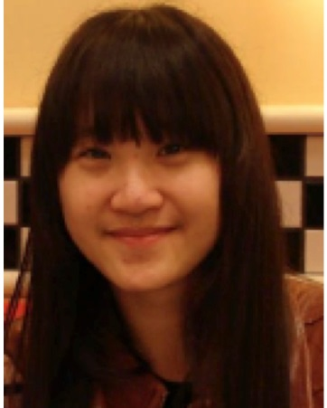




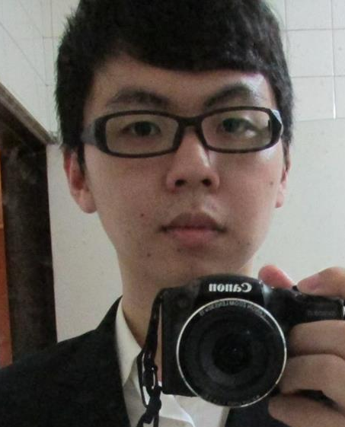


IMTKU Textual Entailment System for Recognizing Inference in Text at NTCIR-11 RITE-VAL 2014
Tamkang University
Min-Yuh Day
Ya-Jung Wang
Che-Wei Hsu
En-Chun Tu
Huai-Wen Hsu
Yu-An Lin
Shang-Yu Wu
Yu-Hsuan Tai
Cheng-Chia Tsai
NTCIR-11 Conference, December 8-12, 2014, Tokyo, Japan

Slide 13

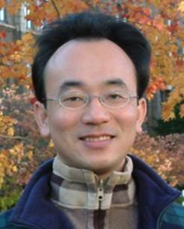
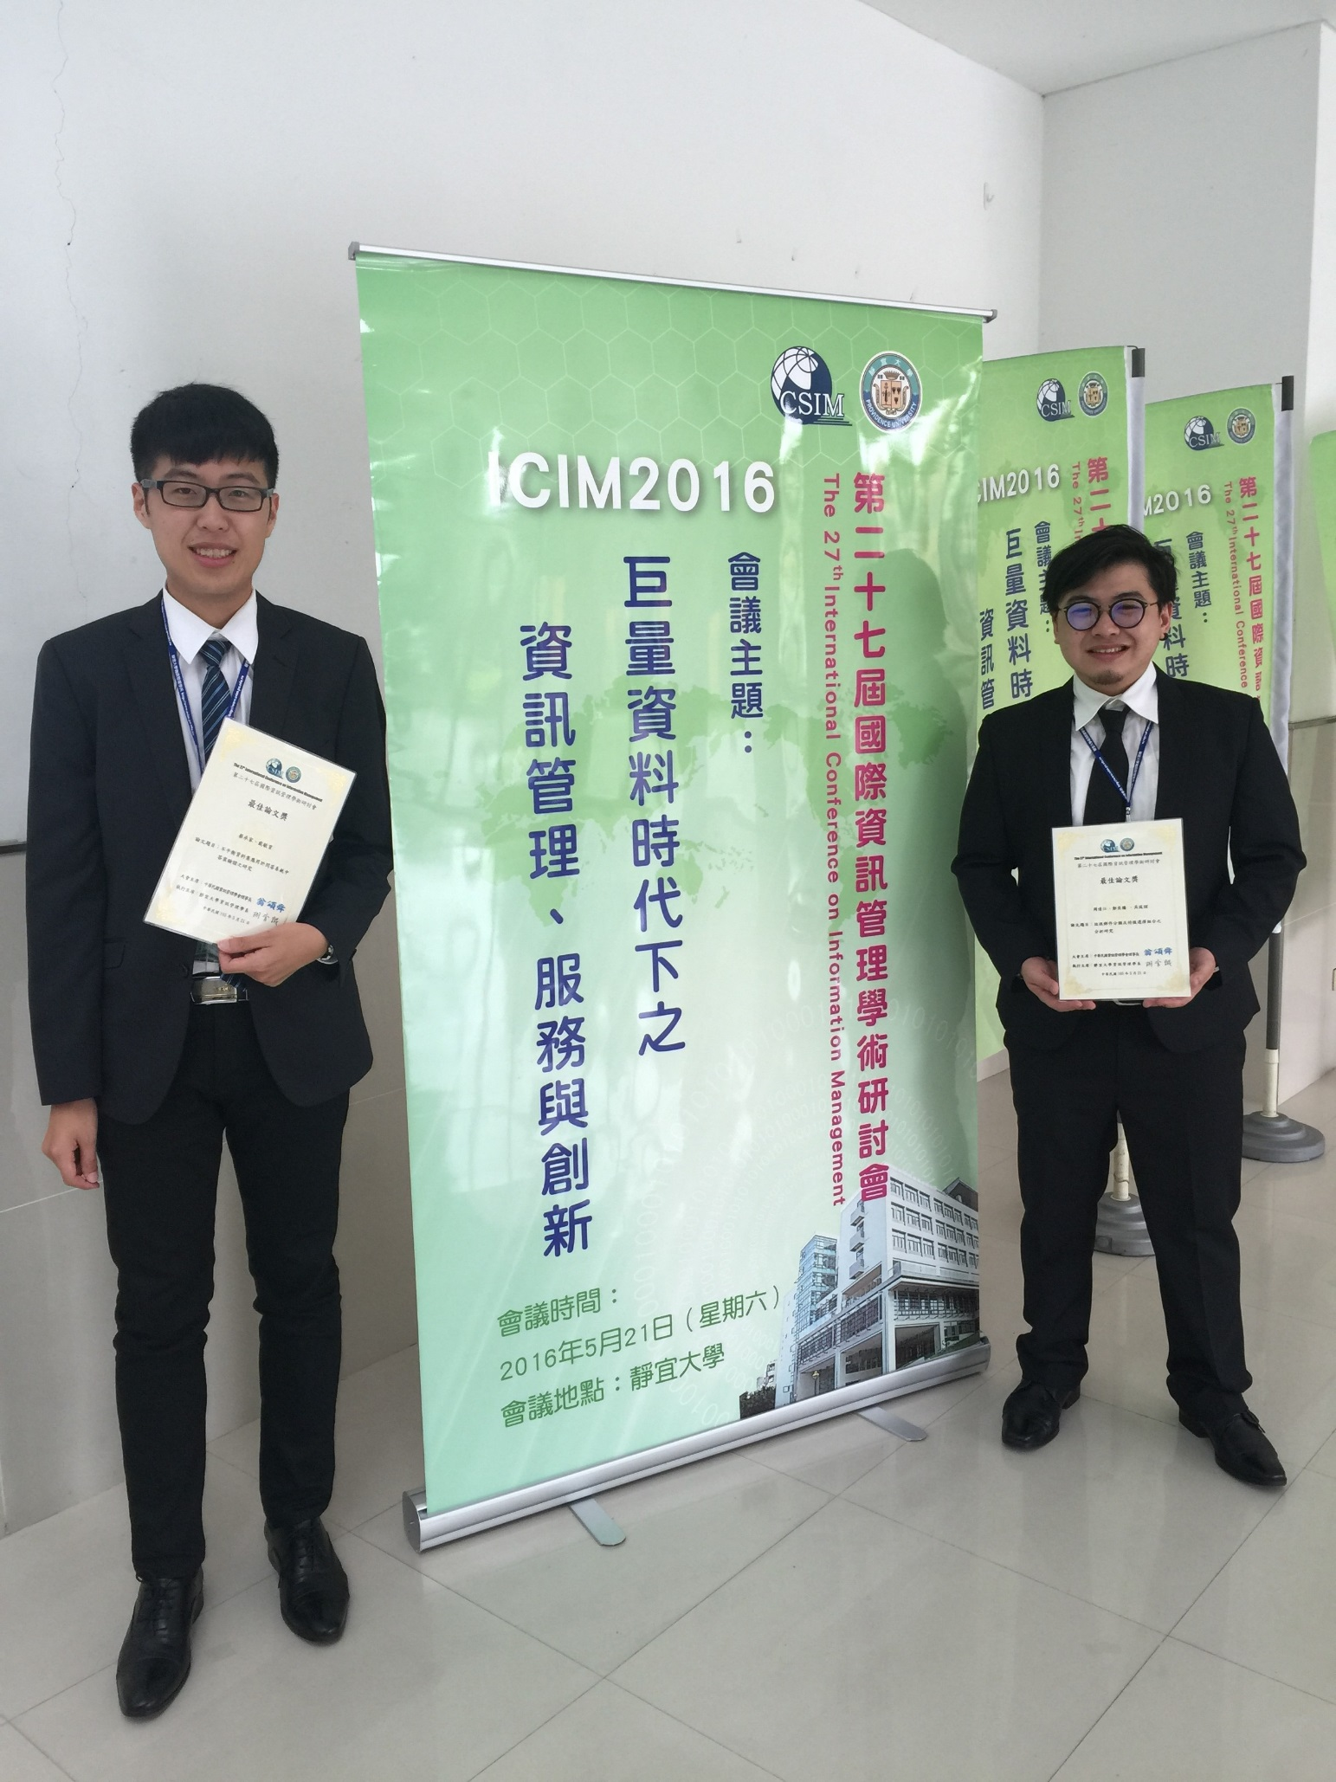
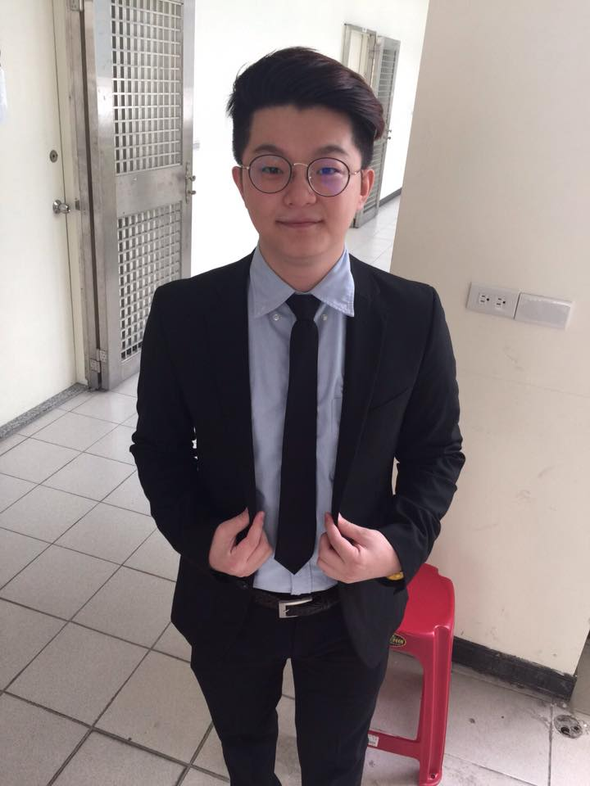
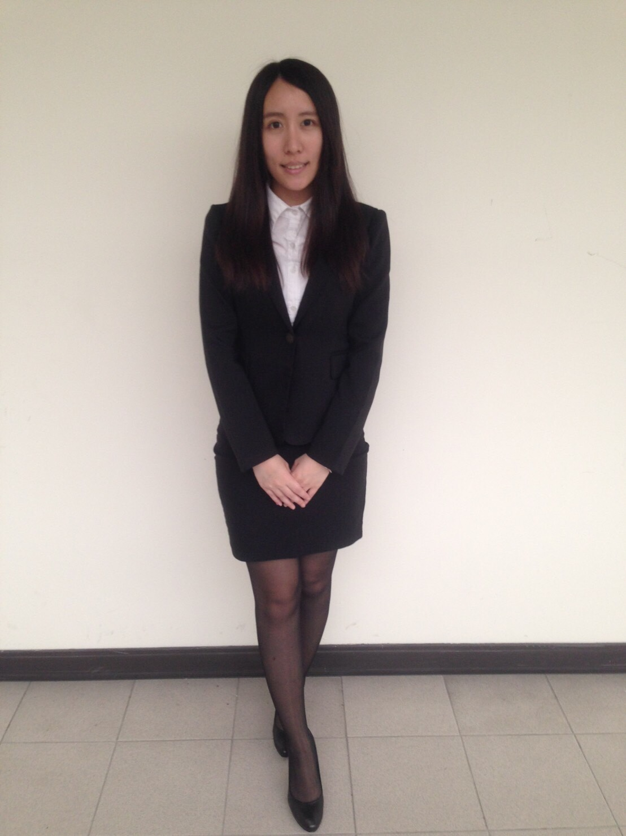
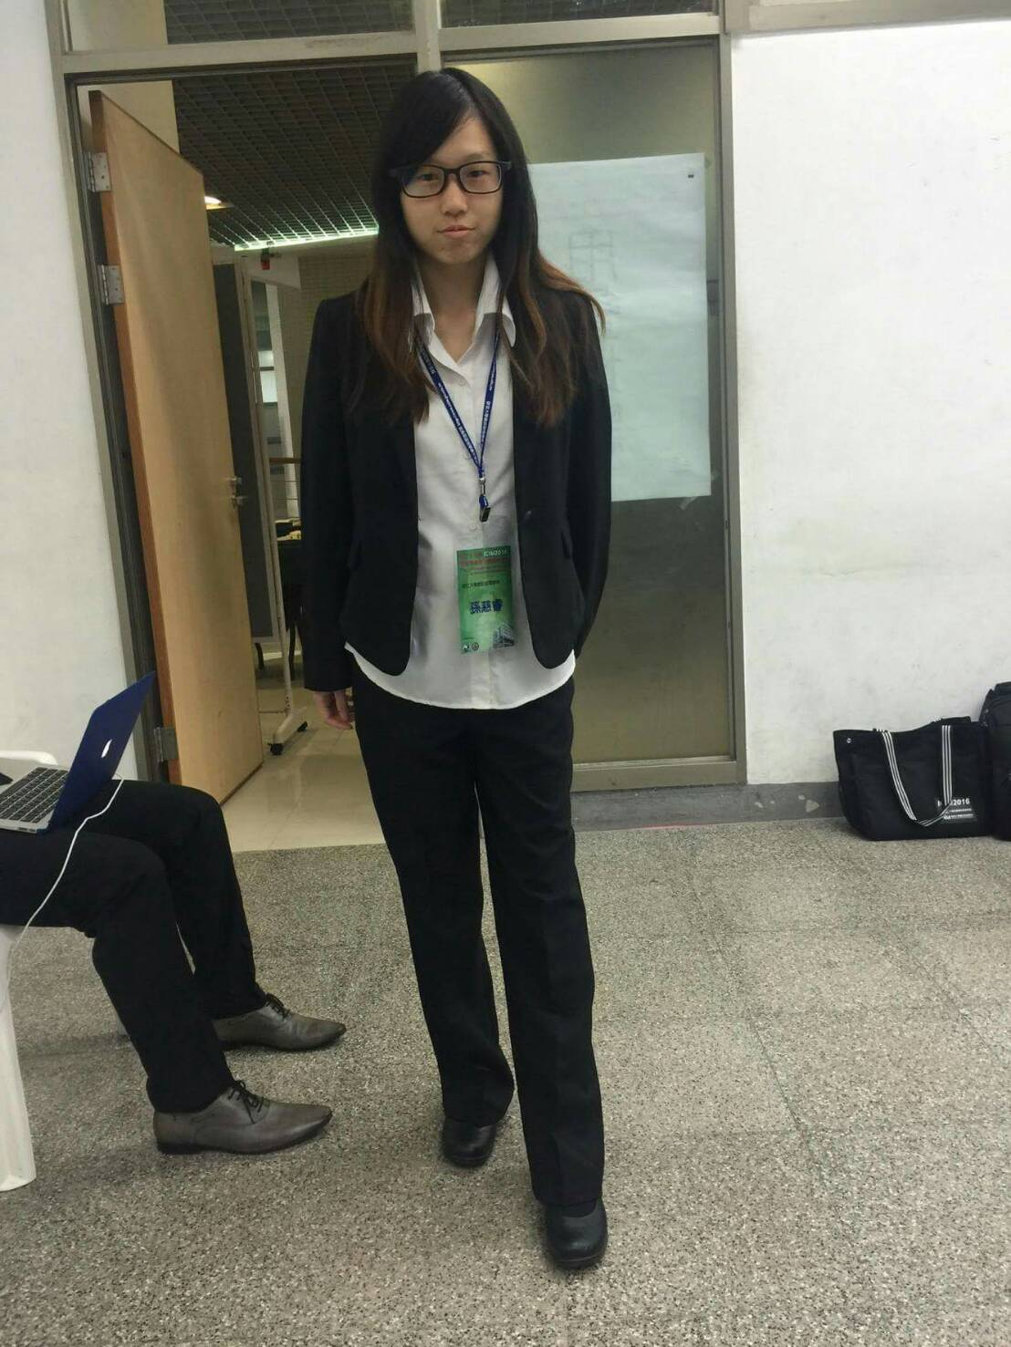

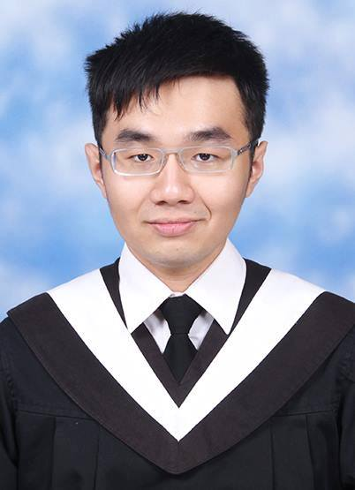
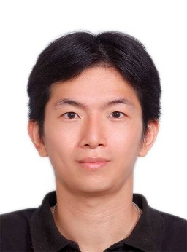
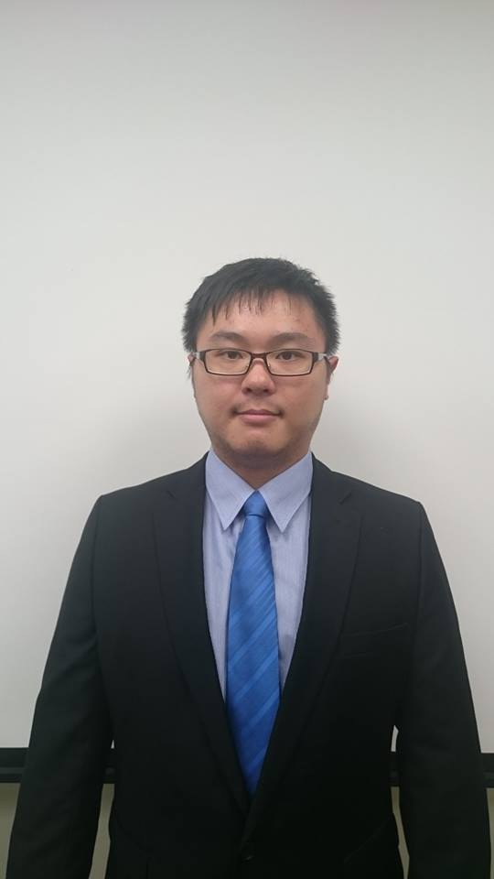
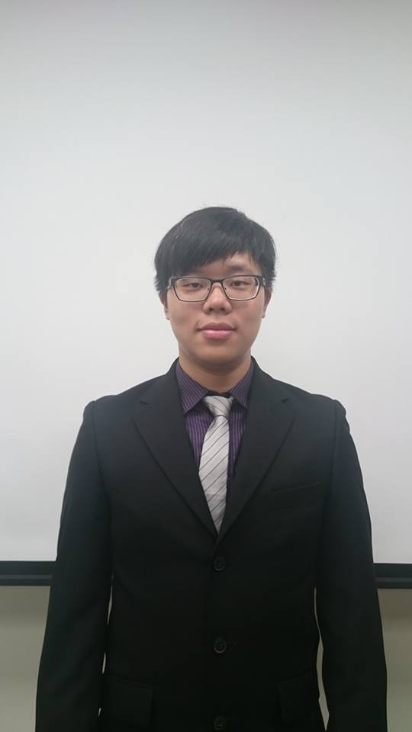
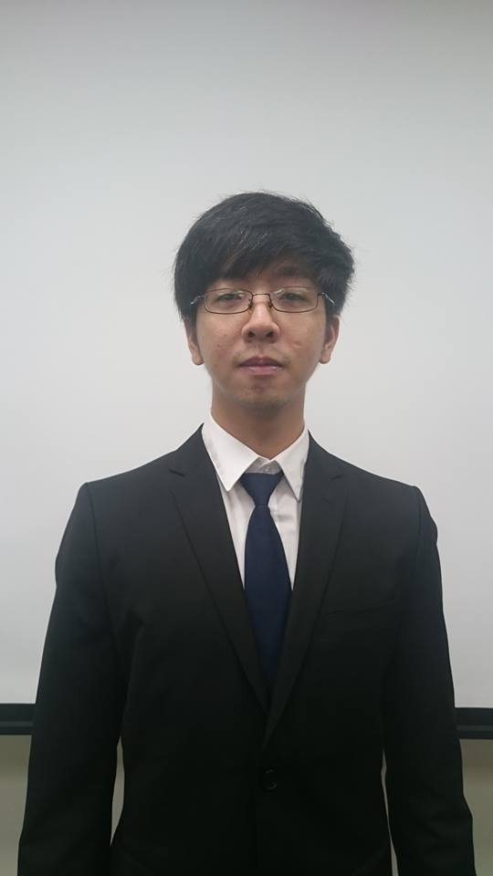
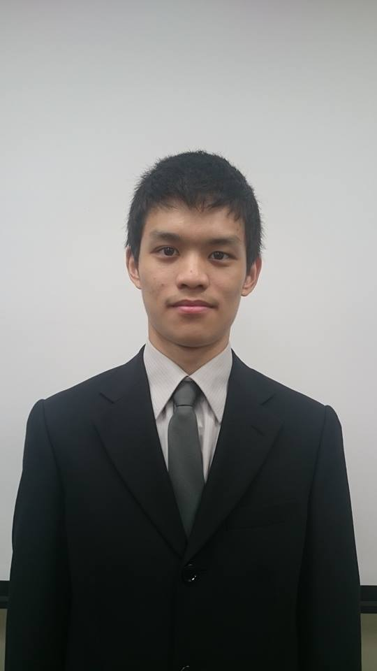

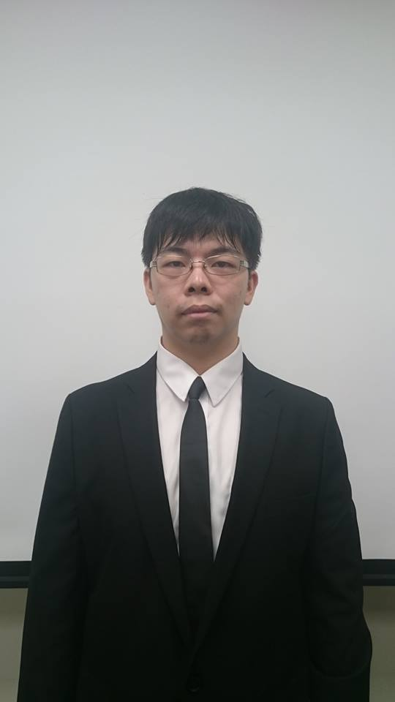
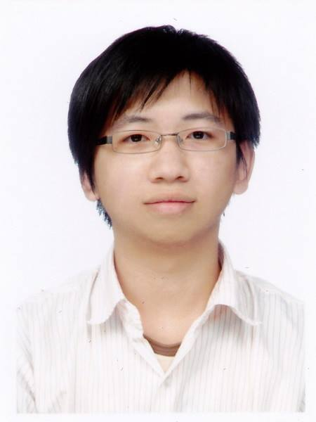
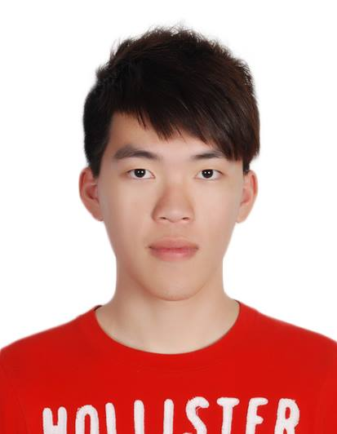
IMTKU Question Answering System for World History Exams at NTCIR-12 QA Lab2
2016
Tamkang University
Department of Information Management
Tamkang University, Taiwan
Sagacity Technology
Min-Yuh Day
Cheng-Chia Tsai
Wei-Chun Chung
Hsiu-Yuan Chang
Tzu-Jui Sun
Yuan-Jie Tsai
Jin-Kun Lin
Cheng-Hung Lee
Yu-Ming Guo
Yue-Da Lin
Wei-Ming Chen
Yun-Da Tsai
Cheng-Jhih Han
Yi-Jing Lin
Yi-Heng Chiang
Ching-Yuan Chien
myday@mail.tku.edu.tw
NTCIR-12 Conference, June 7-10, 2016, Tokyo, Japan

Slide 14
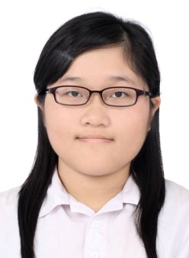

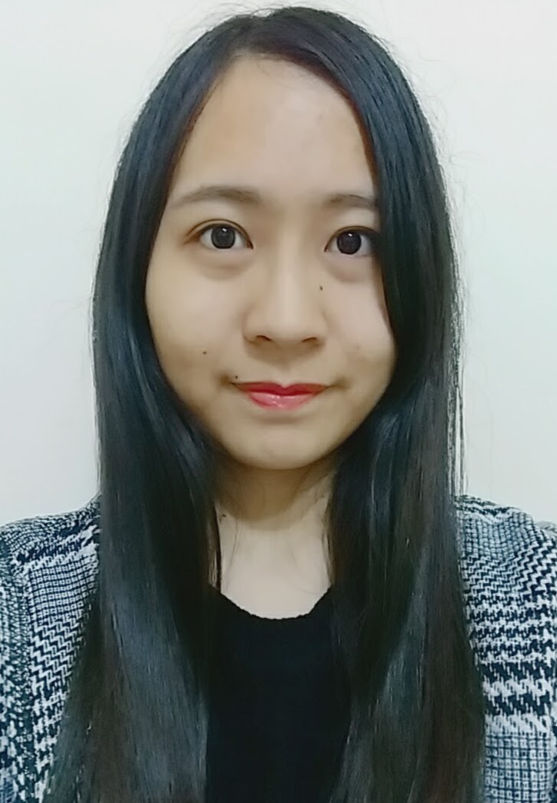

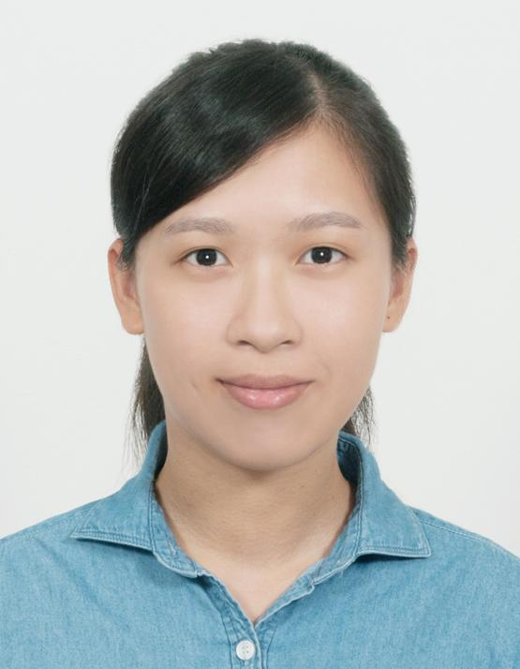
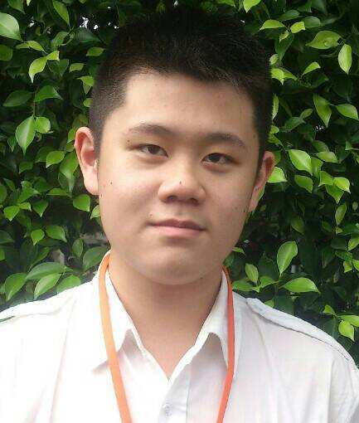
IMTKU Question Answering System for World History Exams at NTCIR-13 QALab-3
2017
Tamkang University
Department of Information Management
Tamkang University, Taiwan
Min-Yuh Day
Chao-Yu Chen
Wanchu Huang
Shi-Ya Zheng
I-Hsuan Huang
Tz-Rung Chen
Min-Chun Kuo
Yue-Da Lin
Yi-Jing Lin
myday@mail.tku.edu.tw
NTCIR-13 Conference, December 5-8, 2017, Tokyo, Japan

Slide 15
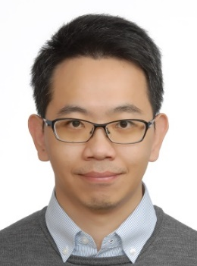


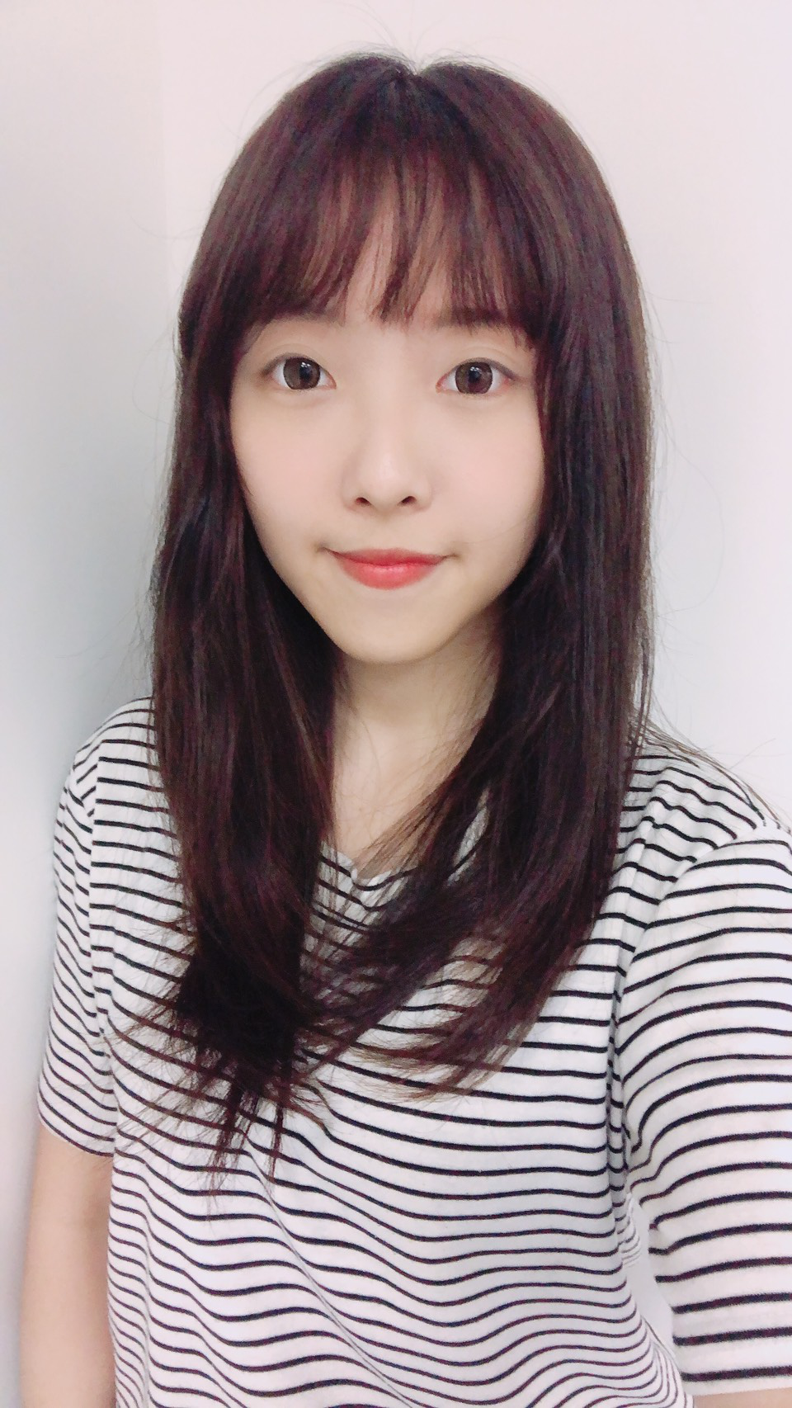
IMTKU Emotional Dialogue System for Short Text Conversation at NTCIR-14 STC-3 (CECG) Task
2019
Tamkang University
Department of Information Management
Tamkang University, Taiwan
Min-Yuh Day
Chi-Sheng Hung
Yi-Jun Xie
Jhih-Yi Chen
Yu-Ling Kuo
Jian-Ting Lin
myday@mail.tku.edu.tw
NTCIR-14 Conference, June 10-13, 2019, Tokyo, Japan

Slide 16
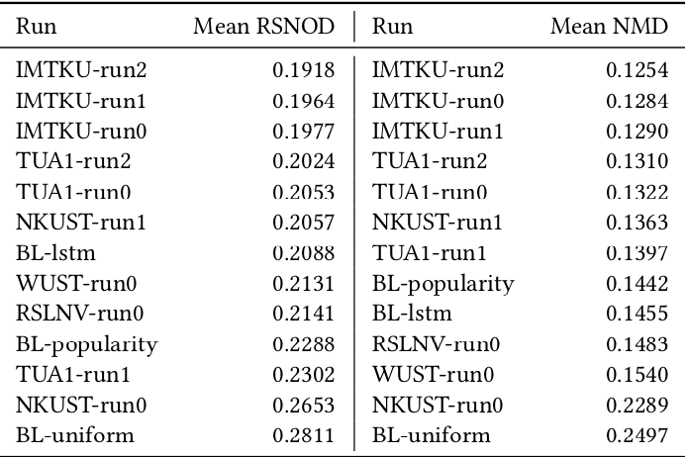
NTCIR-15 Dialogue Evaluation (DialEval-1) Task Dialogue Quality (DQ) and Nugget Detection (ND) Chinese Dialogue Quality (S-score) Results (Zeng et al., 2020)
2020
Source: Zeng, Zhaohao, Sosuke Kato, Tetsuya Sakai, and Inho Kang (2020), “Overview of the NTCIR-15 Dialogue Evaluation (DialEval-1) Task”, Proceedings of NTCIR-15, 2020

Slide 17
IMTKU System Architecture for NTCIR-13 QALab-3
Question (XML)
JA&EN Translator
Complex Essay
Question Analysis
Simple Essay
Stanford CoreNLP
True-or-False
Factoid
Wikipedia
Document Retrieval
Slot-Filling
Unique
Answer Extraction
Answer Generation
Word Embedding
Wiki Word2Vec
Answer (XML)
NTCIR-13 Conference, December 5-8, 2017, Tokyo, Japan

Slide 18
System Architecture of Intelligent Dialogue and Question Answering System
User Question Input
RNN
LSTM
GRU
Deep Learning
TensorFlow
Dialogue Intention Detection
Question Analysis
Python
NLTK
AIML KB
AIML
Dialogue Engine
Dialogue KB
Document Retrieval
IR
Answer Extraction
Cloud
Resource
Real Time
Dialogue
API
Answer Generation
Answer Validation
Deep Learning
System Response Generator
Answer

Slide 19
IMTKU Emotional Dialogue System Architecture
1
3
4
Retrieval-Based Model
Emotion Classification Model
Response
Ranking
Generation-Based Model
2
NTCIR-14 Conference, June 10-13, 2019, Tokyo, Japan

Slide 20
The system architecture of IMTKU retrieval-based model for NTCIR-14 STC-3
Retrieval-Based Model
1
Post
Corpus
Word
Segmentation
Building
Index
Retrieval Model
Keyword
Boolean
Query
Distinct
Result Data
Word2Vec Similarity
Ranking
Solr
Matching
Emotion
Matching
Emotion
Classification
Retrieval-Based
Response
NTCIR-14 Conference, June 10-13, 2019, Tokyo, Japan

Slide 21
The system architecture of IMTKU generation-based model for NTCIR-14 STC-3
Generation-Based Model
2
Training Data
Post
Building Word Index
Word Segmentation
Short Text
Emotion Classifier
Word
Embedding
Training Data
Seq2seq model
Trained Model
Generative Model
Emotion Matching
Generation-Based
Response
Word2Vec Similarity
Ranking
NTCIR-14 Conference, June 10-13, 2019, Tokyo, Japan

Slide 22
The system architecture of IMTKU emotion classification model for NTCIR-14 STC-3
Emotion Classification Model
3
Training
Dataset
MLP
LSTM BiLSTM
Corpus
Emotion
Classification
Testing
Dataset
Emotion
Classification Model
Emotion
Prediction
NTCIR-14 Conference, June 10-13, 2019, Tokyo, Japan

Slide 23
The system architecture of IMTKU Response Ranking for NTCIR-14 STC-3
Response Ranking
4
STC3 Corpus
Chinese Segmentation
using
Jieba
Stop Words
Removal
Word2Vec
1.2 million data (300 dimensions)
Vector of Corpus
NTCIR-14 Conference, June 10-13, 2019, Tokyo, Japan

Slide 24
Short Text Conversation Task (STC-3) Chinese Emotional Conversation Generation (CECG) Subtask
Source: http://coai.cs.tsinghua.edu.cn/hml/challenge.html

Slide 25
NTCIR Short Text Conversation STC-1, STC-2, STC-3
Source: https://waseda.app.box.com/v/STC3atNTCIR-14

Slide 26
Chatbots: Evolution of UI/UX
Source: https://bbvaopen4u.com/en/actualidad/want-know-how-build-conversational-chatbot-here-are-some-tools

Slide 27
AI Humanoid Robo-Advisor

Slide 28
AI Humanoid Robo-Advisor for Multi-channel Conversational Commerce
AI Portfolio
Asset Allocation
Multichannel
Platforms
Web
LINE
Facebook
Humanoid Robot
AI Conversation
Dialog System

Slide 29
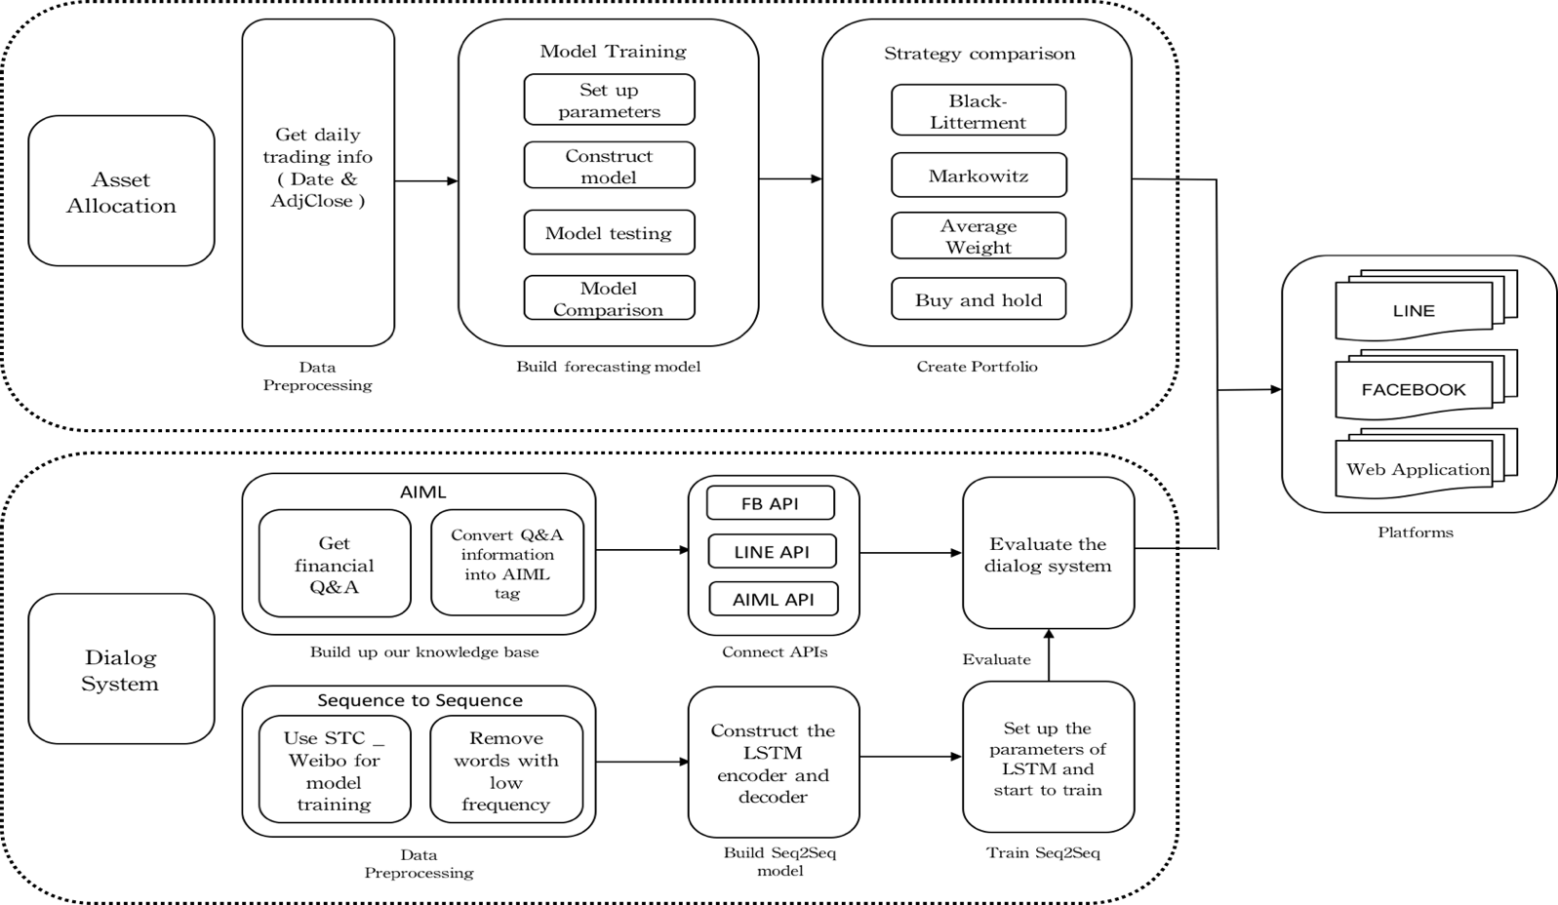
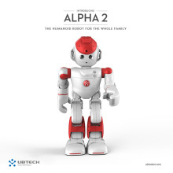
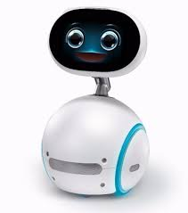
System Architecture of AI Humanoid Robo-Advisor
AI Humanoid Robo-advisor

Slide 30
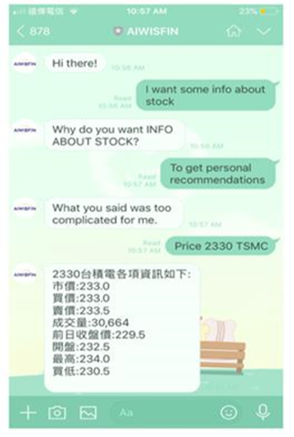
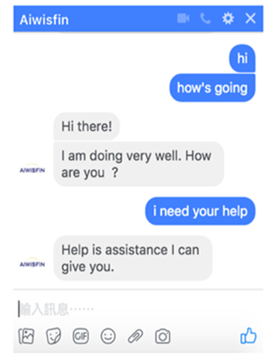
Conversational Model (LINE, FB Messenger)

Slide 31


Conversational Robo-Advisor Multichannel UI/UX Robots
ALPHA 2
ZENBO

Slide 32
AI Dialogue System

Slide 33
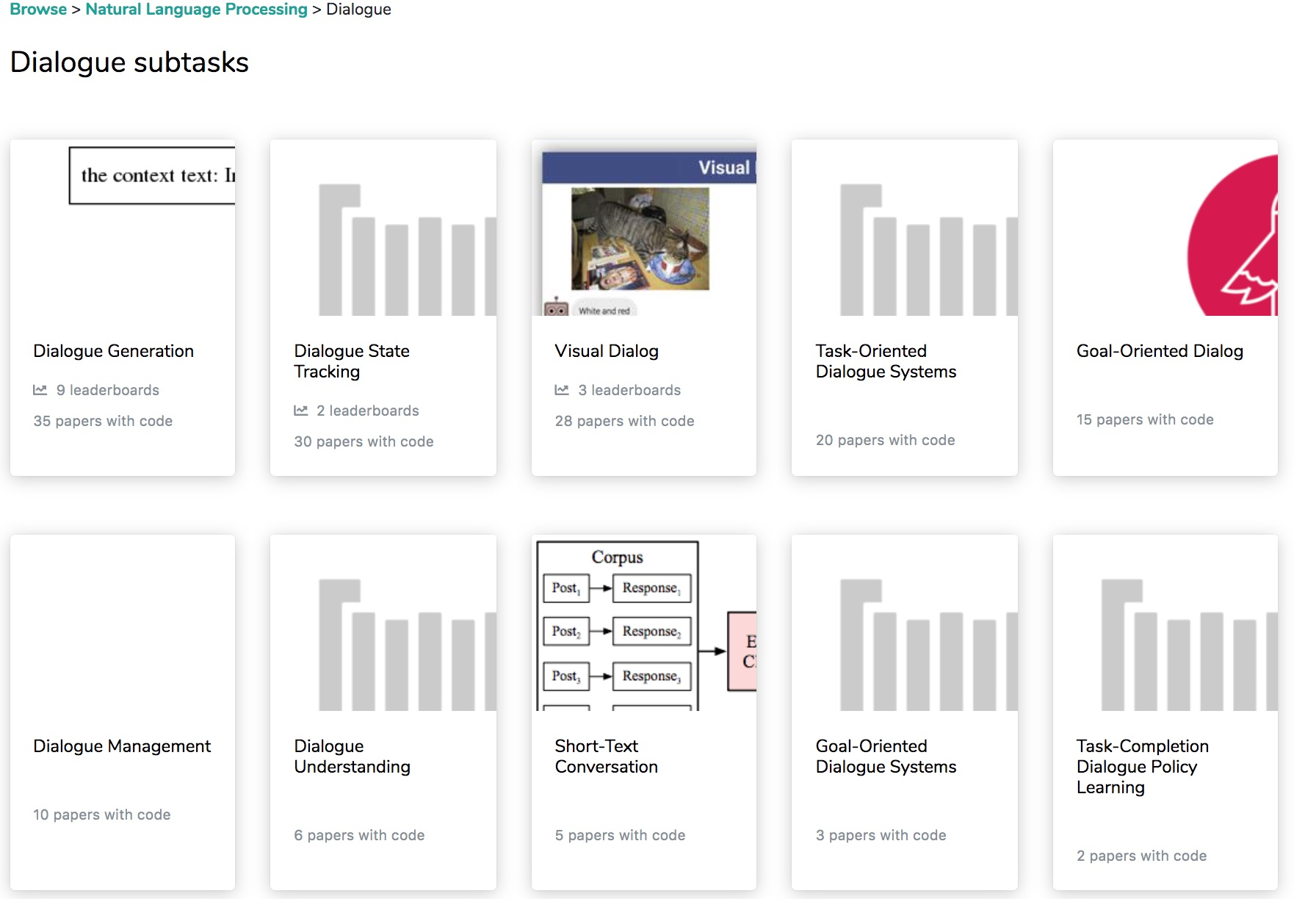
Dialogue Subtasks
Dialogue Generation
Task-Oriented Dialogue Systems
Short-Text Conversation
Source: https://paperswithcode.com/area/natural-language-processing/dialogue

Slide 34
Chatbot Dialogue System Intelligent Agent

Slide 35
Chatbot
Source: https://www.mdsdecoded.com/blog/the-rise-of-chatbots/

Slide 36
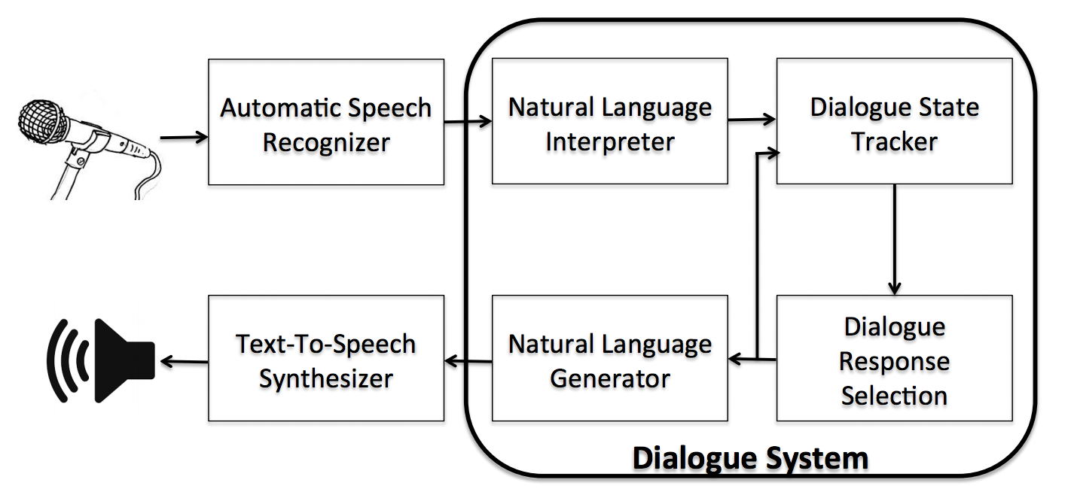
Dialogue System
Source: Serban, I. V., Lowe, R., Charlin, L., & Pineau, J. (2015). A survey of available corpora for building data-driven dialogue systems. arXiv preprint arXiv:1512.05742.

Slide 37
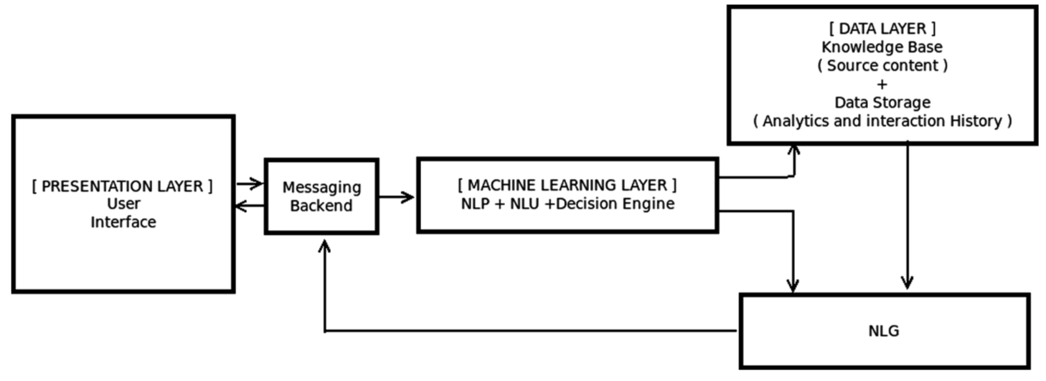
Overall Architecture of Intelligent Chatbot
Source: Borah, Bhriguraj, Dhrubajyoti Pathak, Priyankoo Sarmah, Bidisha Som, and Sukumar Nandi. "Survey of Textbased Chatbot in Perspective of Recent Technologies." In International Conference on Computational Intelligence, Communications, and Business Analytics, pp. 84-96. Springer, Singapore, 2018.

Slide 38
Can machines think? (Alan Turing ,1950)
Source: Cahn, Jack. "CHATBOT: Architecture, Design, & Development." PhD diss., University of Pennsylvania, 2017.

Slide 39
Chatbot “online human-computer dialog system with natural language.”
Source: Cahn, Jack. "CHATBOT: Architecture, Design, & Development." PhD diss., University of Pennsylvania, 2017.

Slide 40
Chatbot Conversation Framework
Source: https://chatbotslife.com/ultimate-guide-to-leveraging-nlp-machine-learning-for-you-chatbot-531ff2dd870c

Slide 41
Chatbots Bot Maturity Model
Customers want to have simpler means to interact with businesses and get faster response to a question or complaint.
Source: https://www.capgemini.com/2017/04/how-can-chatbots-meet-expectations-introducing-the-bot-maturity/

Slide 42
From E-Commerce to Conversational Commerce: Chatbots and Virtual Assistants
Source: http://www.guided-selling.org/from-e-commerce-to-conversational-commerce/

Slide 43
Conversational Commerce: eBay AI Chatbots
Source: https://www.forbes.com/sites/rachelarthur/2017/07/19/conversational-commerce-ebay-ai-chatbot/

Slide 44
Hotel Chatbot
Intent Detection
Slot Filling
Source: https://sdtimes.com/amazon/guest-view-capitalize-amazon-lex-available-general-public/

Slide 45
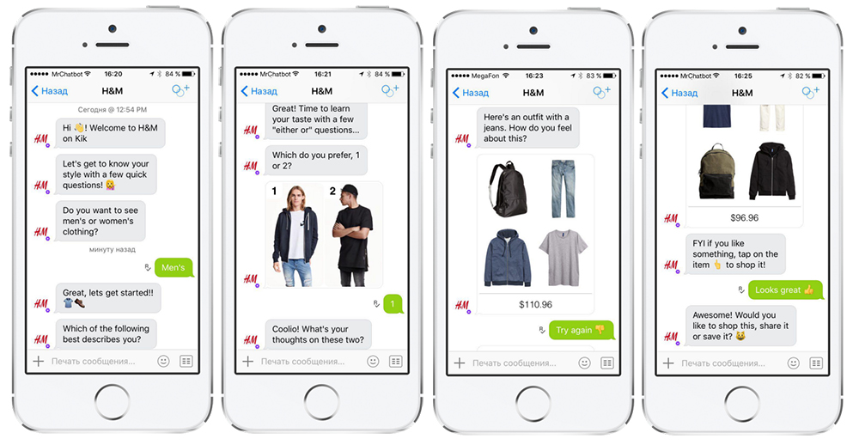
H&M’s Chatbot on Kik
Source: http://www.guided-selling.org/from-e-commerce-to-conversational-commerce/

Slide 46
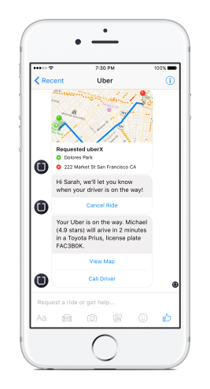
Uber’s Chatbot on Facebook’s Messenger
Uber’s chatbot on Facebook’s messenger - one main benefit: it loads much faster than the Uber app
Source: http://www.guided-selling.org/from-e-commerce-to-conversational-commerce/

Slide 47
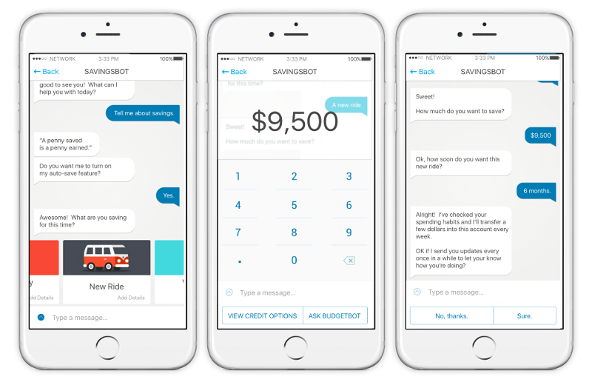
Savings Bot
Source: https://chatbotsmagazine.com/artificial-intelligence-ai-and-fintech-part-1-7cae1e67dc13

Slide 48
Mastercard Makes Commerce More Conversational
Source: https://newsroom.mastercard.com/press-releases/mastercard-makes-commerce-more-conversational-with-launch-of-chatbots-for-banks-and-merchants/

Slide 49
Bot Life Cycle and Platform Ecosystem

Slide 50
The Bot Lifecycle
Source: https://chatbotsmagazine.com/the-bot-lifecycle-1ff357430db7

Slide 51
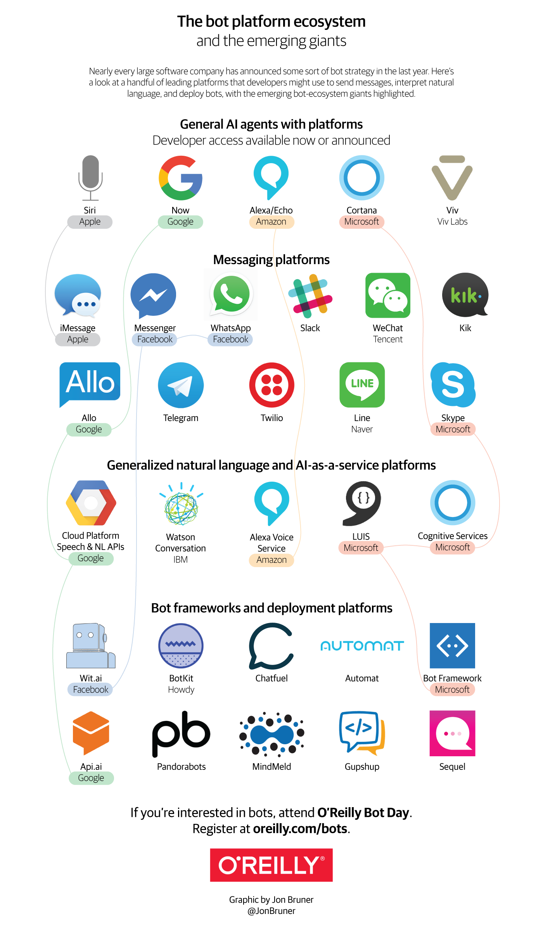
Source: https://www.oreilly.com/ideas/infographic-the-bot-platform-ecosystem

Slide 52
Source: https://www.oreilly.com/ideas/infographic-the-bot-platform-ecosystem

Slide 53
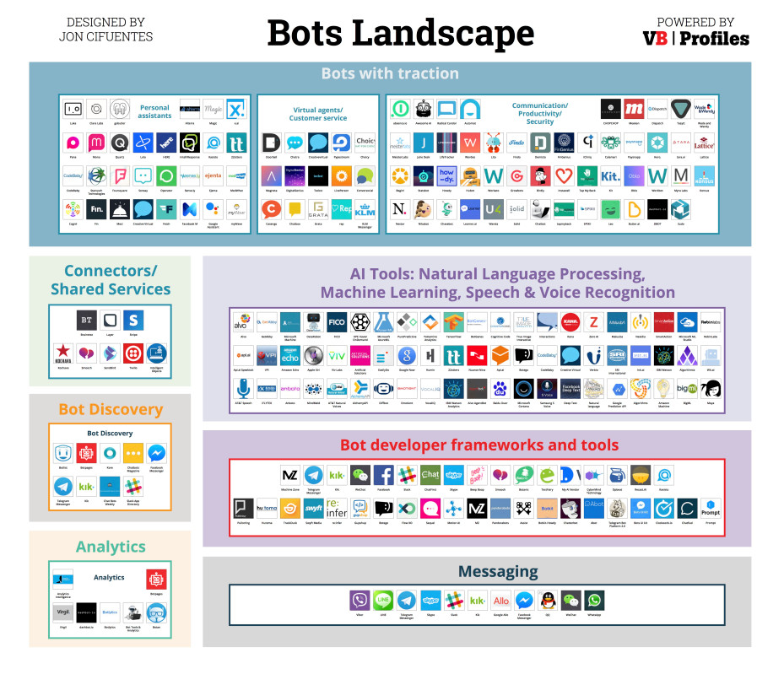
Source: https://venturebeat.com/2016/08/11/introducing-the-bots-landscape-170-companies-4-billion-in-funding-thousands-of-bots/

Slide 54
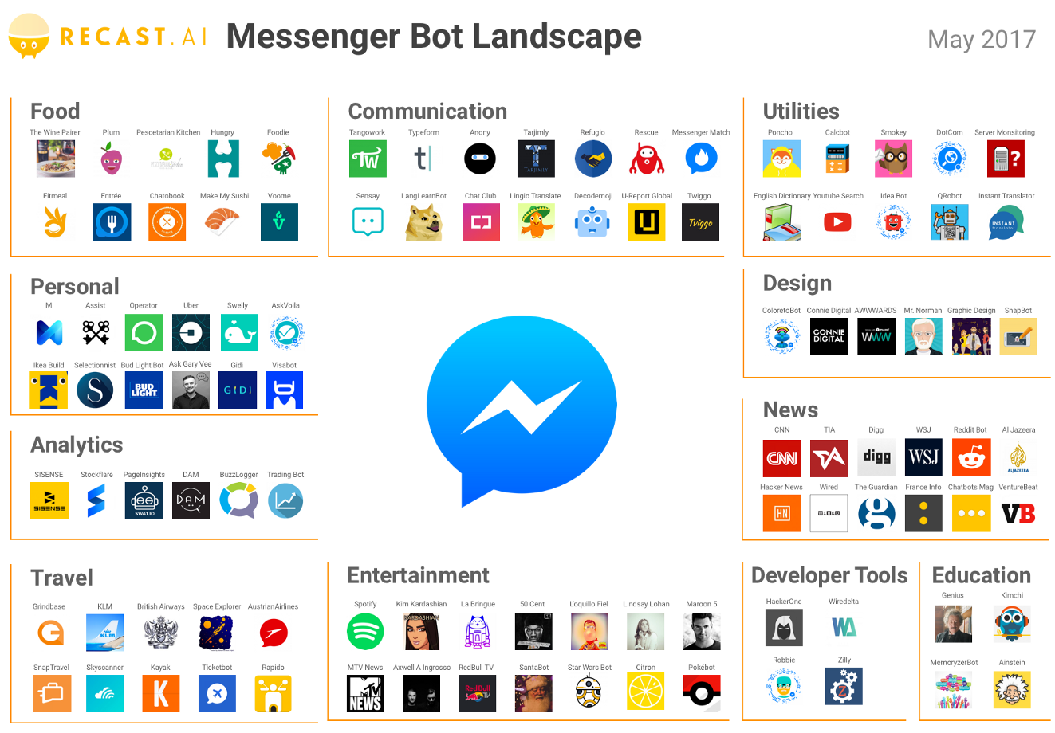
Source: https://medium.com/@RecastAI/2017-messenger-bot-landscape-a-public-spreadsheet-gathering-1000-messenger-bots-f017fdb1448a /

Slide 55
How to Build Chatbots
Source: Igor Bobriakov (2018), https://activewizards.com/blog/a-comparative-analysis-of-chatbots-apis/

Slide 56
Chatbot Frameworks and AI Services
Bot Frameworks
Botkit
Microsoft Bot Framework
Rasa NLU
AI Services
Wit.ai
api.ai
LUIS.ai
IBM Watson
Source: Igor Bobriakov (2018), https://activewizards.com/blog/a-comparative-analysis-of-chatbots-apis/

Slide 57
Chatbot Frameworks
Source: Igor Bobriakov (2018), https://activewizards.com/blog/a-comparative-analysis-of-chatbots-apis/

Slide 58
Source: Igor Bobriakov (2018), https://activewizards.com/blog/a-comparative-analysis-of-chatbots-apis/

Slide 59
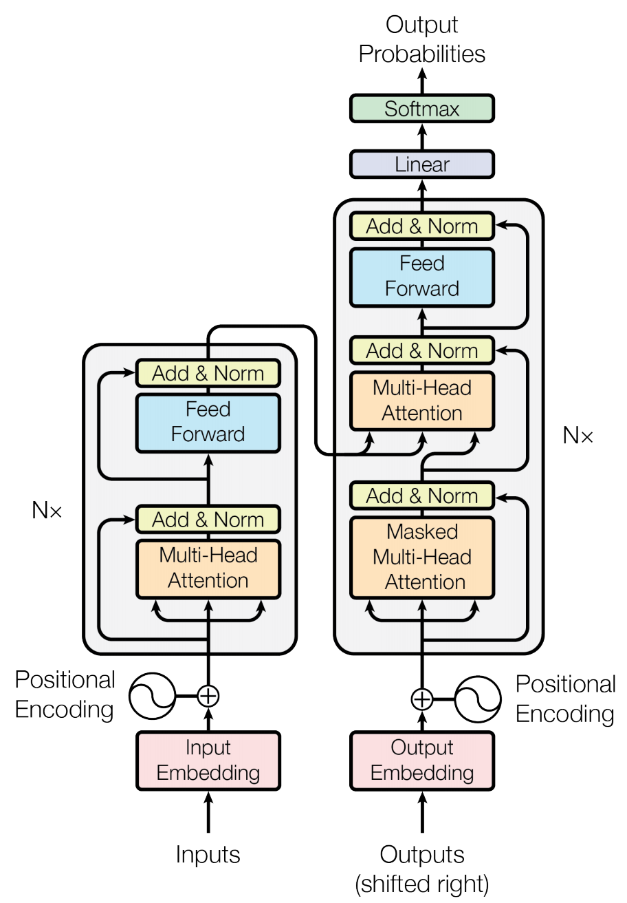
Transformer (Attention is All You Need) (Vaswani et al., 2017)
Source: Vaswani, Ashish, Noam Shazeer, Niki Parmar, Jakob Uszkoreit, Llion Jones, Aidan N. Gomez, Łukasz Kaiser, and Illia Polosukhin. "Attention is all you need." In Advances in neural information processing systems, pp. 5998-6008. 2017.

Slide 60
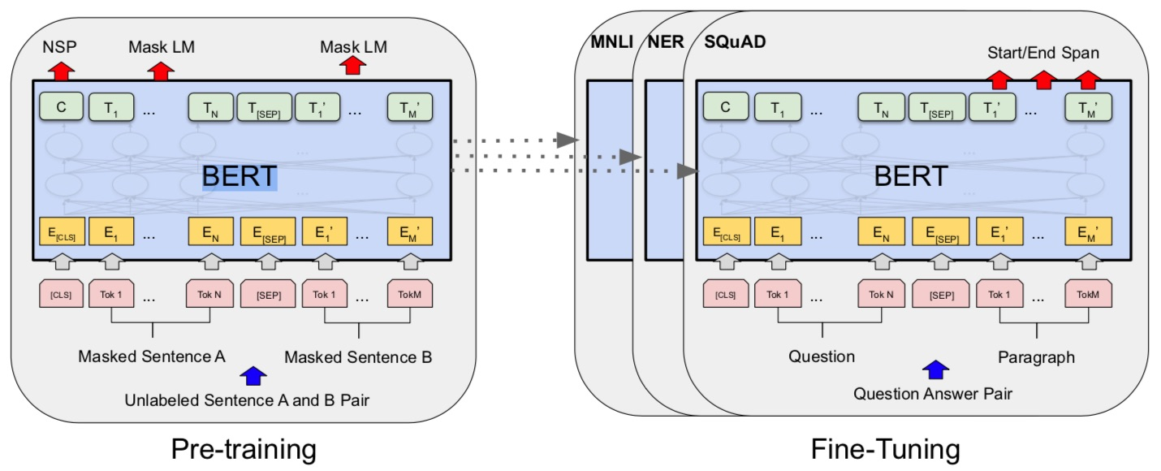
BERT: Pre-training of Deep Bidirectional Transformers for Language Understanding
BERT (Bidirectional Encoder Representations from Transformers)
Overall pre-training and fine-tuning procedures for BERT
Source: Devlin, Jacob, Ming-Wei Chang, Kenton Lee, and Kristina Toutanova (2018). "Bert: Pre-training of deep bidirectional transformers for language understanding." arXiv preprint arXiv:1810.04805.

Slide 61
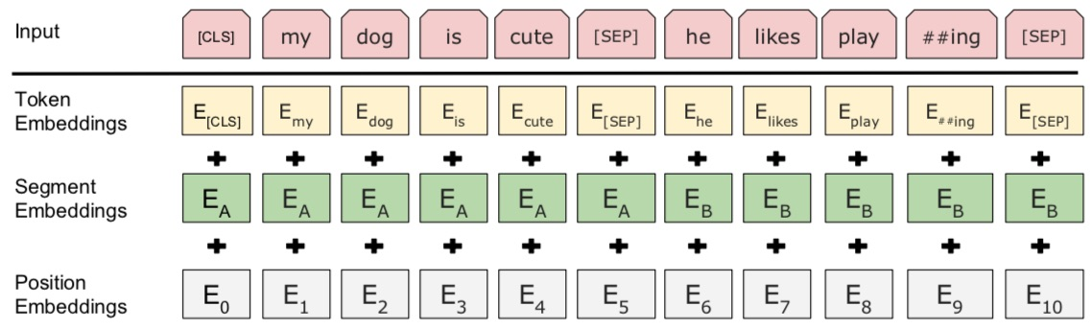
BERT: Pre-training of Deep Bidirectional Transformers for Language Understanding
BERT (Bidirectional Encoder Representations from Transformers)
BERT input representation
Source: Devlin, Jacob, Ming-Wei Chang, Kenton Lee, and Kristina Toutanova (2018). "Bert: Pre-training of deep bidirectional transformers for language understanding." arXiv preprint arXiv:1810.04805.

Slide 62
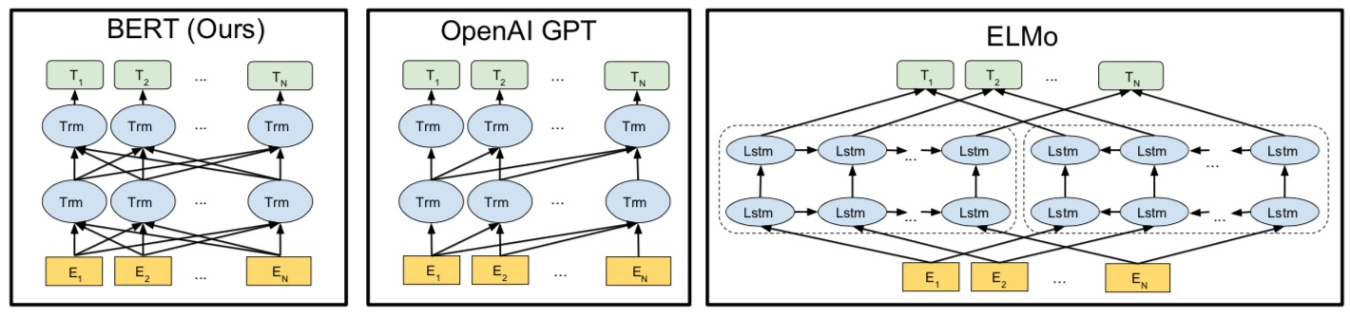
BERT, OpenAI GPT, ELMo
Source: Devlin, Jacob, Ming-Wei Chang, Kenton Lee, and Kristina Toutanova (2018). "Bert: Pre-training of deep bidirectional transformers for language understanding." arXiv preprint arXiv:1810.04805.

Slide 63
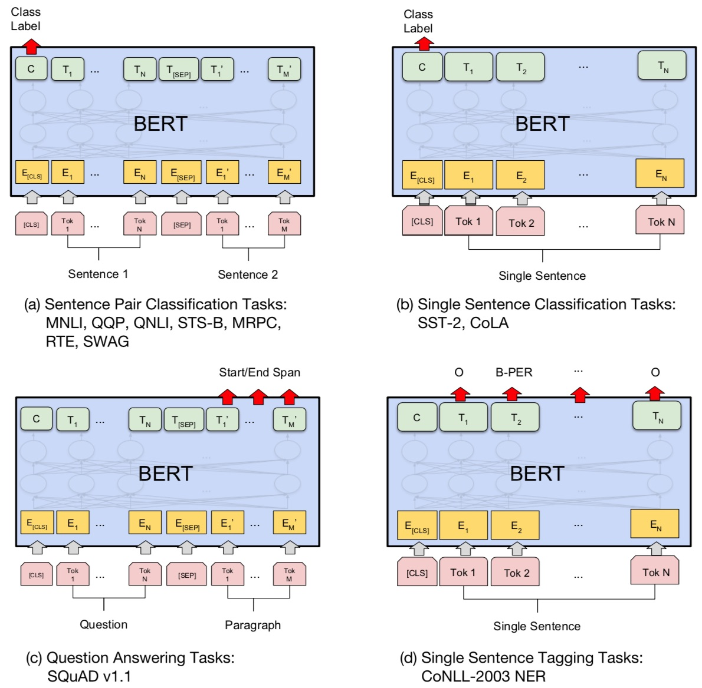
Fine-tuning BERT on Different Tasks
Source: Devlin, Jacob, Ming-Wei Chang, Kenton Lee, and Kristina Toutanova (2018). "Bert: Pre-training of deep bidirectional transformers for language understanding." arXiv preprint arXiv:1810.04805.

Slide 64
Fine-tuning BERT on Question Answering (QA)
Source: Devlin, Jacob, Ming-Wei Chang, Kenton Lee, and Kristina Toutanova (2018). "Bert: Pre-training of deep bidirectional transformers for language understanding." arXiv preprint arXiv:1810.04805.

Slide 65
Fine-tuning BERT on Dialogue Intent Detection (ID; Classification)
Source: Devlin, Jacob, Ming-Wei Chang, Kenton Lee, and Kristina Toutanova (2018). "Bert: Pre-training of deep bidirectional transformers for language understanding." arXiv preprint arXiv:1810.04805.

Slide 66
Fine-tuning BERT on Dialogue Slot Filling (SF)
Source: Devlin, Jacob, Ming-Wei Chang, Kenton Lee, and Kristina Toutanova (2018). "Bert: Pre-training of deep bidirectional transformers for language understanding." arXiv preprint arXiv:1810.04805.

Slide 67
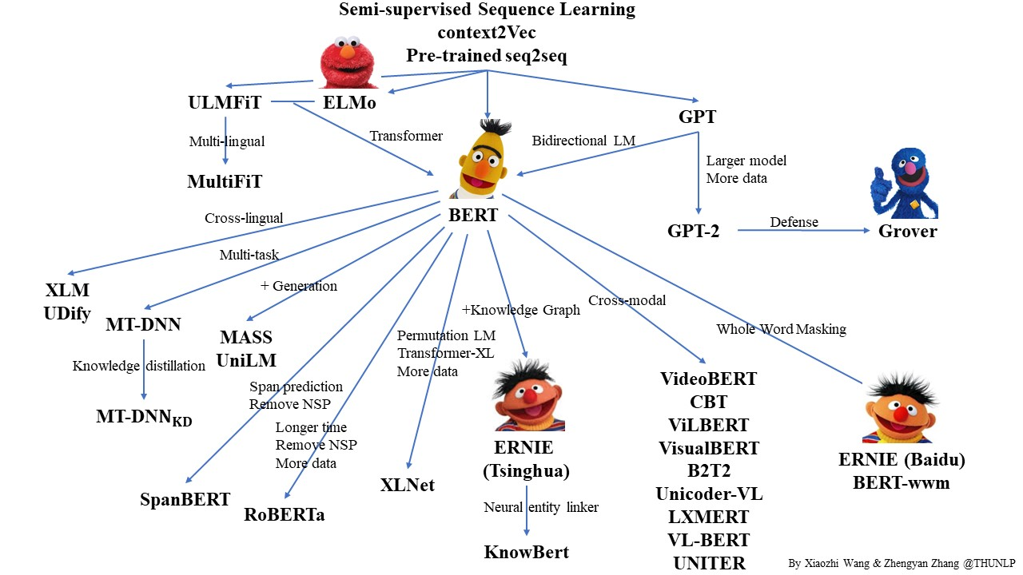
Pre-trained Language Model (PLM)
Source: https://github.com/thunlp/PLMpapers

Slide 68
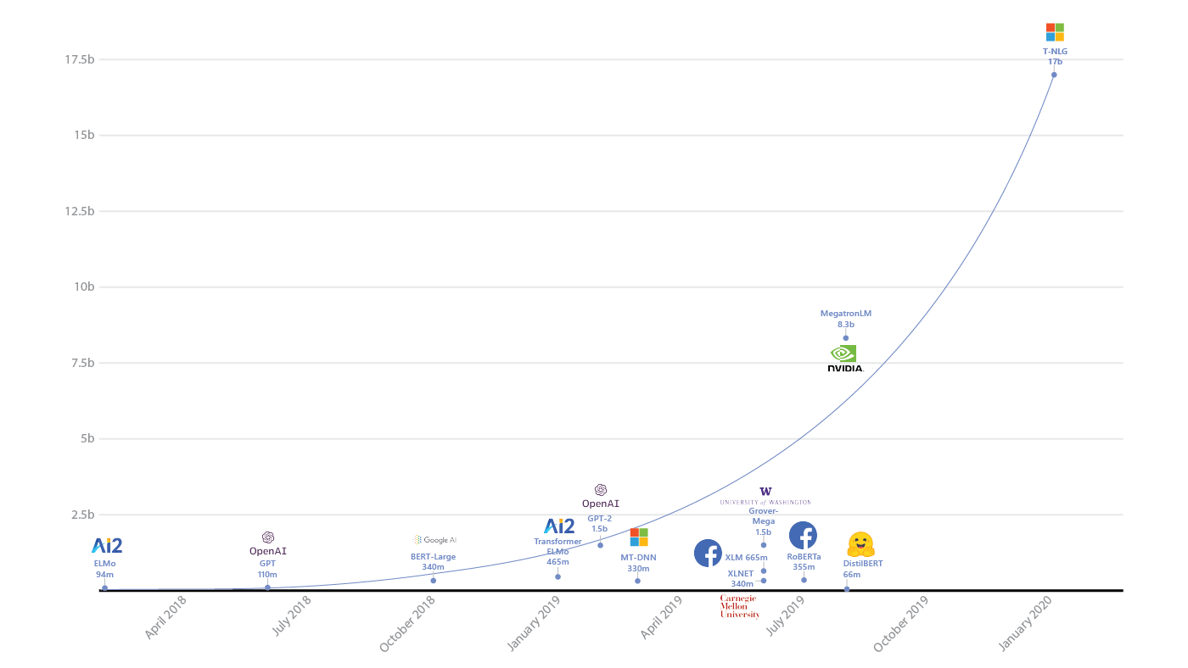
Turing Natural Language Generation (T-NLG)
T-NLG
17b
MegatronLM
8.3b
GPT-2
1.5b
BERT-Large
340m
RoBERTa
355m
DistilBERT
66m
2018
2019
2020
Source: https://www.microsoft.com/en-us/research/blog/turing-nlg-a-17-billion-parameter-language-model-by-microsoft/

Slide 69
Transformers State-of-the-art Natural Language Processing for TensorFlow 2.0 and PyTorch
Transformers
pytorch-transformers
pytorch-pretrained-bert
provides state-of-the-art general-purpose architectures
(BERT, GPT-2, RoBERTa, XLM, DistilBert, XLNet, CTRL...)
for Natural Language Understanding (NLU) and Natural Language Generation (NLG) with over 32+ pretrained models in 100+ languages and deep interoperability between TensorFlow 2.0 and PyTorch.
Source: https://github.com/huggingface/transformers

Slide 70
Transfer Learning in Natural Language Processing
Source: Sebastian Ruder, Matthew E. Peters, Swabha Swayamdipta, and Thomas Wolf (2019), "Transfer learning in natural language processing." In Proceedings of the 2019 Conference of the North American Chapter of the Association for Computational Linguistics: Tutorials, pp. 15-18.

Slide 71
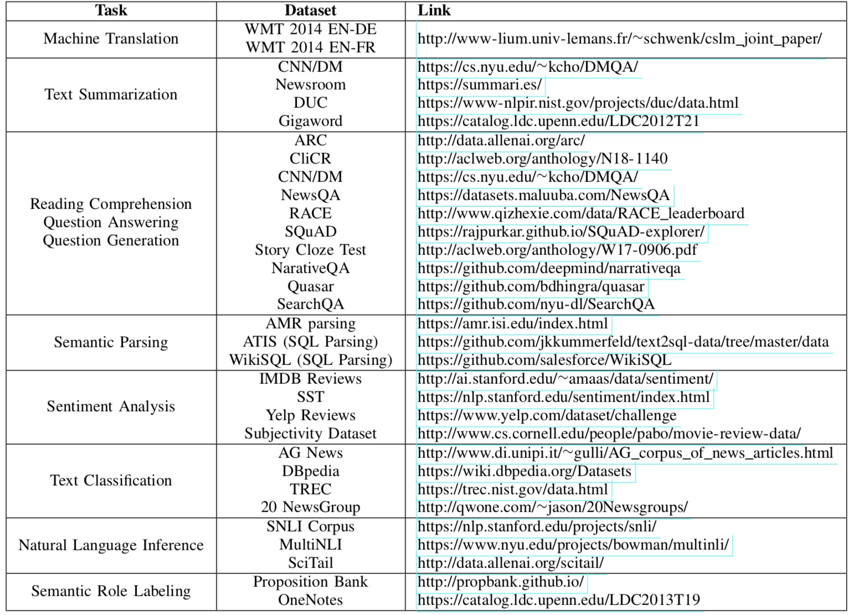
NLP Benchmark Datasets
Source: Amirsina Torfi, Rouzbeh A. Shirvani, Yaser Keneshloo, Nader Tavvaf, and Edward A. Fox (2020). "Natural Language Processing Advancements By Deep Learning: A Survey." arXiv preprint arXiv:2003.01200.

Slide 72
Question Answering (QA) SQuAD Stanford Question Answering Dataset

Slide 73
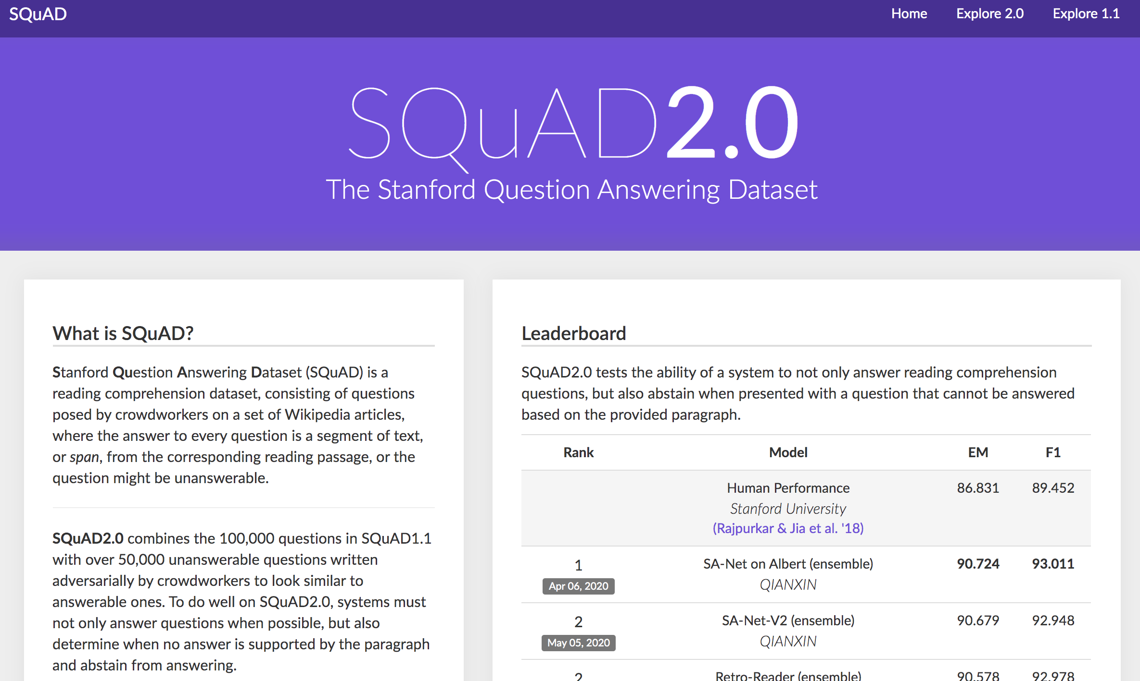
SQuAD
https://rajpurkar.github.io/SQuAD-explorer/

Slide 74
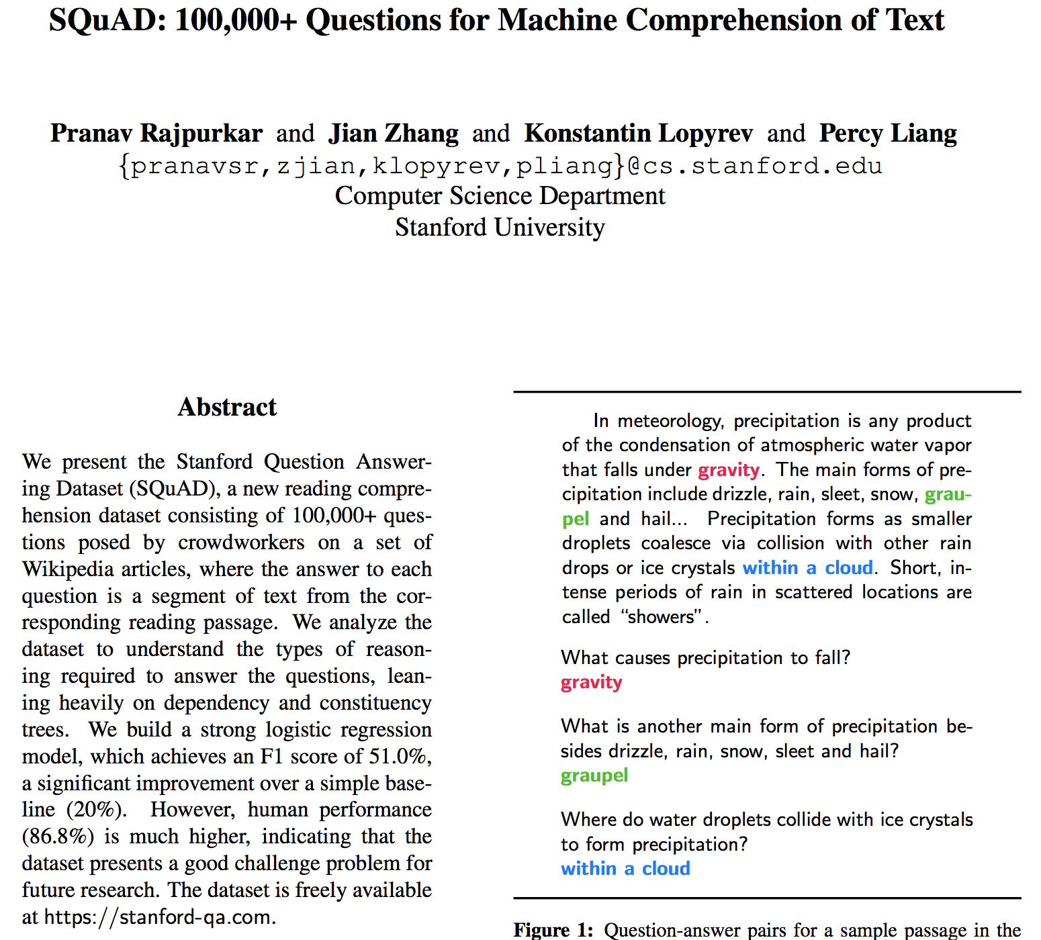
SQuAD
Source: Rajpurkar, Pranav, Jian Zhang, Konstantin Lopyrev, and Percy Liang. "Squad: 100,000+ questions for machine comprehension of text." arXiv preprint arXiv:1606.05250 (2016).

Slide 75

SQuAD (Question Answering)
Q: What causes precipitation to fall?
https://en.wikipedia.org/wiki/Precipitation

Slide 76
SQuAD (Question Answering)
Paragraph
In meteorology, precipitation is any product of the condensation of atmospheric water vapor that falls under gravity. The main forms of precipitation include drizzle, rain, sleet, snow, graupel and hail... Precipitation forms as smaller droplets coalesce via collision with other rain drops or ice crystals within a cloud. Short, intense periods of rain in scattered locations are called “showers”.
Q: What causes precipitation to fall?

Slide 77
SQuAD (Question Answering)
In meteorology, precipitation is any product of the condensation of atmospheric water vapor that falls under gravity. The main forms of precipitation include drizzle, rain, sleet, snow, graupel and hail... Precipitation forms as smaller droplets coalesce via collision with other rain drops or ice crystals within a cloud. Short, intense periods of rain in scattered locations are called “showers”.
Q: What causes precipitation to fall?
A: gravity

Slide 78
SQuAD (Question Answering)
In meteorology, precipitation is any product of the condensation of atmospheric water vapor that falls under gravity. The main forms of precipitation include drizzle, rain, sleet, snow, graupel and hail... Precipitation forms as smaller droplets coalesce via collision with other rain drops or ice crystals within a cloud. Short, intense periods of rain in scattered locations are called “showers”.
Q: What is another main form of precipitation besides drizzle, rain, snow, sleet and hail?
A: graupel

Slide 79
SQuAD (Question Answering)
In meteorology, precipitation is any product of the condensation of atmospheric water vapor that falls under gravity. The main forms of precipitation include drizzle, rain, sleet, snow, graupel and hail... Precipitation forms as smaller droplets coalesce via collision with other rain drops or ice crystals within a cloud. Short, intense periods of rain in scattered locations are called “showers”.
Q: Where do water droplets collide with ice crystals to form precipitation?
A: within a cloud

Slide 80
SQuAD (Question Answering)
In meteorology, precipitation is any product of the condensation of atmospheric water vapor that falls under gravity. The main forms of precipitation include drizzle, rain, sleet, snow, graupel and hail... Precipitation forms as smaller droplets coalesce via collision with other rain drops or ice crystals within a cloud. Short, intense periods of rain in scattered locations are called “showers”.
Q: What causes precipitation to fall?
A: gravity
Q: What is another main form of precipitation besides drizzle, rain, snow, sleet and hail?
A: graupel
Q: Where do water droplets collide with ice crystals to form precipitation?
A: within a cloud

Slide 81

SQuAD (Question Answering)
https://en.wikipedia.org/wiki/Super_Bowl_50

Slide 82
Dialogue on Airline Travel Information System (ATIS)

Slide 83

The ATIS (Airline Travel Information System) Dataset
https://www.kaggle.com/siddhadev/atis-dataset-from-ms-cntk
Training samples: 4978
Testing samples: 893
Vocab size: 943
Slot count: 129
Intent count: 26
Source: Haihong, E., Peiqing Niu, Zhongfu Chen, and Meina Song. "A novel bi-directional interrelated model for joint intent detection and slot filling." In Proceedings of the 57th Annual Meeting of the Association for Computational Linguistics, pp. 5467-5471. 2019.

Slide 84

SF-ID Network (E et al., 2019) Slot Filling (SF) Intent Detection (ID)
A Novel Bi-directional Interrelated Model for Joint Intent Detection and Slot Filling
Source: Haihong, E., Peiqing Niu, Zhongfu Chen, and Meina Song. "A novel bi-directional interrelated model for joint intent detection and slot filling." In Proceedings of the 57th Annual Meeting of the Association for Computational Linguistics, pp. 5467-5471. 2019.

Slide 85

Intent Detection on ATIS State-of-the-art
Source: https://paperswithcode.com/sota/intent-detection-on-atis

Slide 86

Slot Filling on ATIS State-of-the-art
Source: https://paperswithcode.com/sota/slot-filling-on-atis

Slide 87
Restaurants Dialogue Datasets
MIT Restaurant Corpus
https://groups.csail.mit.edu/sls/downloads/restaurant/
CamRest676 (Cambridge restaurant dialogue domain dataset)
https://www.repository.cam.ac.uk/handle/1810/260970
DSTC2 (Dialog State Tracking Challenge 2 & 3)
http://camdial.org/~mh521/dstc/

Slide 88

CrossWOZ: A Large-Scale Chinese Cross-Domain Task-Oriented Dialogue Dataset
Source: Zhu, Qi, Kaili Huang, Zheng Zhang, Xiaoyan Zhu, and Minlie Huang. "Crosswoz: A large-scale chinese cross-domain task-oriented dialogue dataset." arXiv preprint arXiv:2002.11893 (2020).

Slide 89

CrossWOZ: A Large-Scale Chinese Cross-Domain Task-Oriented Dialogue Dataset
Source: Zhu, Qi, Kaili Huang, Zheng Zhang, Xiaoyan Zhu, and Minlie Huang. "Crosswoz: A large-scale chinese cross-domain task-oriented dialogue dataset." arXiv preprint arXiv:2002.11893 (2020).

Slide 90


Task-Oriented Dialogue
Source: Zhu, Qi, Kaili Huang, Zheng Zhang, Xiaoyan Zhu, and Minlie Huang. "Crosswoz: A large-scale chinese cross-domain task-oriented dialogue dataset." arXiv preprint arXiv:2002.11893 (2020).

Slide 91
任務型對話系統 The Evaluation of Chinese Human-Computer Dialogue Technology, SMP2019-ECDT
自然語言理解 Natural Language Understanding (NLU)
對話管理 Dialog Management (DM)
自然語言生成 Natural Language Generation (NLG)
Source: http://conference.cipsc.org.cn/smp2019/evaluation.html
https://github.com/OnionWang/SMP2019-ECDT-NLU

Slide 92

Python in Google Colab (Python101)
https://colab.research.google.com/drive/1FEG6DnGvwfUbeo4zJ1zTunjMqf2RkCrT
Question Answering and Dialogue Systems
https://tinyurl.com/aintpupython101

Slide 93

Python in Google Colab (Python101)
https://colab.research.google.com/drive/1FEG6DnGvwfUbeo4zJ1zTunjMqf2RkCrT
https://tinyurl.com/aintpupython101

Slide 94

Python in Google Colab (Python101)
https://colab.research.google.com/drive/1FEG6DnGvwfUbeo4zJ1zTunjMqf2RkCrT
https://tinyurl.com/aintpupython101

Slide 95

Python in Google Colab (Python101)
https://colab.research.google.com/drive/1FEG6DnGvwfUbeo4zJ1zTunjMqf2RkCrT
https://tinyurl.com/aintpupython101

Slide 96

Python in Google Colab (Python101)
https://colab.research.google.com/drive/1FEG6DnGvwfUbeo4zJ1zTunjMqf2RkCrT
https://tinyurl.com/aintpupython101

Slide 97
NLP Benchmark Datasets
Source: Amirsina Torfi, Rouzbeh A. Shirvani, Yaser Keneshloo, Nader Tavvaf, and Edward A. Fox (2020). "Natural Language Processing Advancements By Deep Learning: A Survey." arXiv preprint arXiv:2003.01200.

Slide 98
Summary
Question Answering
Dialogue Systems
Task Oriented Dialogue System

Slide 99
References
Day, Min-Yuh and Chi-Sheng Hung, "AI Affective Conversational Robot with Hybrid Generative-based and Retrieval-based Dialogue Models", in Proceedings of The 20th IEEE International Conference on Information Reuse and Integration for Data Science (IEEE IRI 2019), Los Angeles, CA, USA, July 30 - August 1, 2019.
Day, Min-Yuh, Chi-Sheng Hung, Yi-Jun Xie, Jhih-Yi Chen, Yu-Ling Kuo and Jian-Ting Lin (2019), "IMTKU Emotional Dialogue System for Short Text Conversation at NTCIR-14 STC-3 (CECG) Task", The 14th NTCIR Conference on Evaluation of Information Access Technologies (NTCIR-14), Tokyo, Japan, June 10-13, 2019.
Zhou, Hao, Minlie Huang, Tianyang Zhang, Xiaoyan Zhu, and Bing Liu. "Emotional chatting machine: emotional conversation generation with internal and external memory." arXiv preprint arXiv:1704.01074 (2017).
Yu, Kai, Zijian Zhao, Xueyang Wu, Hongtao Lin, and Xuan Liu. "Rich Short Text Conversation Using Semantic Key Controlled Sequence Generation." IEEE/ACM Transactions on Audio, Speech, and Language Processing (2018).
Borah, Bhriguraj, Dhrubajyoti Pathak, Priyankoo Sarmah, Bidisha Som, and Sukumar Nandi. "Survey of Textbased Chatbot in Perspective of Recent Technologies." In International Conference on Computational Intelligence, Communications, and Business Analytics, pp. 84-96. Springer, Singapore, 2018.
Haihong, E., Peiqing Niu, Zhongfu Chen, and Meina Song. "A novel bi-directional interrelated model for joint intent detection and slot filling." In Proceedings of the 57th Annual Meeting of the Association for Computational Linguistics, pp. 5467-5471. 2019.
Rajpurkar, Pranav, Jian Zhang, Konstantin Lopyrev, and Percy Liang. "Squad: 100,000+ questions for machine comprehension of text." arXiv preprint arXiv:1606.05250 (2016).
Zhu, Qi, Kaili Huang, Zheng Zhang, Xiaoyan Zhu, and Minlie Huang. "Crosswoz: A large-scale chinese cross-domain task-oriented dialogue dataset." arXiv preprint arXiv:2002.11893 (2020).
Zeng, Zhaohao, Sosuke Kato, Tetsuya Sakai, and Inho Kang (2020), “Overview of the NTCIR-15 Dialogue Evaluation (DialEval-1) Task”, Proceedings of NTCIR-15, 2020.
Apoorv Nandan (2020), BERT (from HuggingFace Transformers) for Text Extraction, https://keras.io/examples/nlp/text_extraction_with_bert/
Olivier Grisel (2020), Transformers (BERT fine-tuning): Joint Intent Classification and Slot Filling, https://m2dsupsdlclass.github.io/lectures-labs/
Dipanjan Sarkar (2019), Text Analytics with Python: A Practitioner’s Guide to Natural Language Processing, Second Edition. APress. https://github.com/Apress/text-analytics-w-python-2e
Benjamin Bengfort, Rebecca Bilbro, and Tony Ojeda (2018), Applied Text Analysis with Python, O'Reilly Media. https://www.oreilly.com/library/view/applied-text-analysis/9781491963036/
HuggingFace (2020), Transformers Notebook, https://huggingface.co/transformers/notebooks.html
The Super Duper NLP Repo, https://notebooks.quantumstat.com/
Min-Yuh Day (2020), Python 101, https://tinyurl.com/aintpupython101

Slide 100
Q & A
問答系統與對話系統 (Question Answering and Dialogue Systems)
Min-Yuh Day
戴敏育
Associate Professor
副教授
Institute of Information Management, National Taipei University
國立臺北大學 資訊管理研究所
https://web.ntpu.edu.tw/~myday
2020-10-23

